Slide 1
Health Prediction System Using Machine Learning & Python
Presented By
Team -5

Slide 2
CONTENTS
INTRODUCTION
WORK FLOW
WORKING
RESULTS
CONCLUSION

Slide 3
INTRODUCTION
Identifying diabetes, heart disease, and Parkinson’s is tough due to unclear symptoms.
Variability in data and human subjectivity leads to misclassification and delayed diagnosis.
ML boosts diagnostic accuracy by spotting patterns in patient information.
It predicts diseases early, aiding in targeted care for patients.
Using ML Early detection becomes simpler, facilitating prompt treatment.
ML provides objective, data-driven diagnostic insights, supporting better medical decision-making.

Slide 4
WORK FLOW
Data Collection ---> Data Preprocessing ---> Train Model ---> Model Evaluation
---> Model Prediction ---> Display Results ---> Save Model ---> Load Model

Slide 5
Data Collection ---> Data Preprocessing ---> Train Model ---> Model Evaluation
---> Model Prediction ---> Display Results ---> Save Model ---> Load Model

Slide 6
WORKING
DATA COLLECTION
We collect the datasets from Kaggle
The sizes of heart disease dataset is 768*9
The sizes of Parkinson's disease dataset is 195*24
The sizes of diabetes disease dataset is 303*14
DATA PREPROCESSING
We check for null values in dataset and eliminate them using appropriate techniques
We use one hot encoding for converting categorical data to numerical data(0 → healthy ,1→ unhealthy)
We select important features by correlation using heatmap

Slide 7
Model Building
We consider Logistic Regression for building heart diseases predictive system
We consider SVM for building Parkinson's disease predictive system
We consider SVM for building diabetes disease predictive system
Performance Measure
We consider Accuracy as performance measure
The results on train and test set by each model is as shown in the following graph

Slide 9
DEPLOYING THE MODEL
Streamlit streamlines web app development, minimizing code for accessible deployment at all skill levels.
Seamless integration with machine learning models in Streamlit allows for quick deployment and interaction.
Streamlit offers easy-to-use widgets, simplifying user input for dynamic and user-friendly interfaces.
So we used streamlit for our model deployment and results of stremlit interface is show below

Slide 10
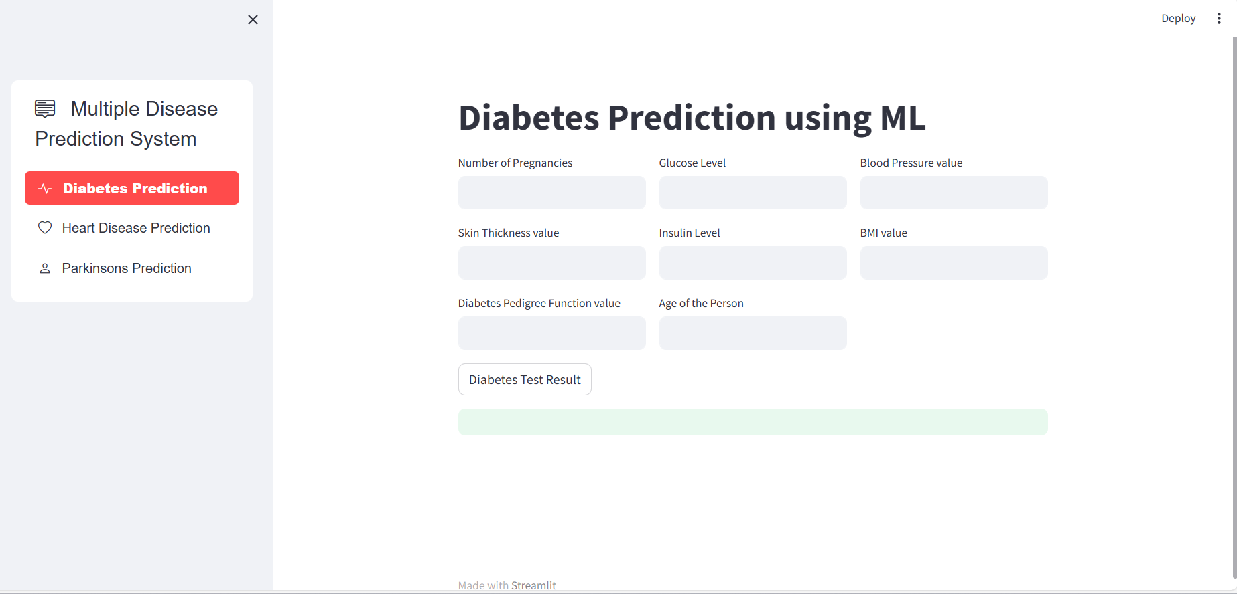

Slide 11
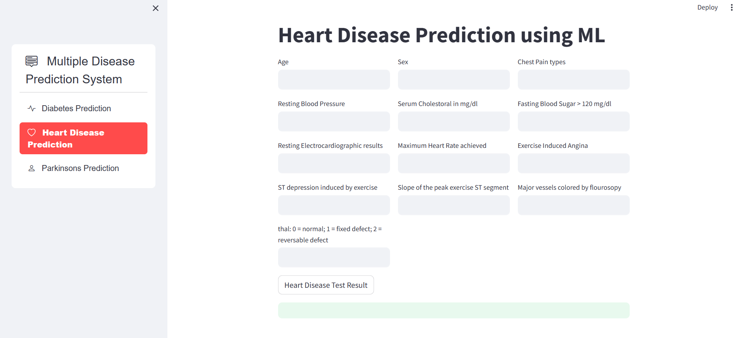

Slide 12
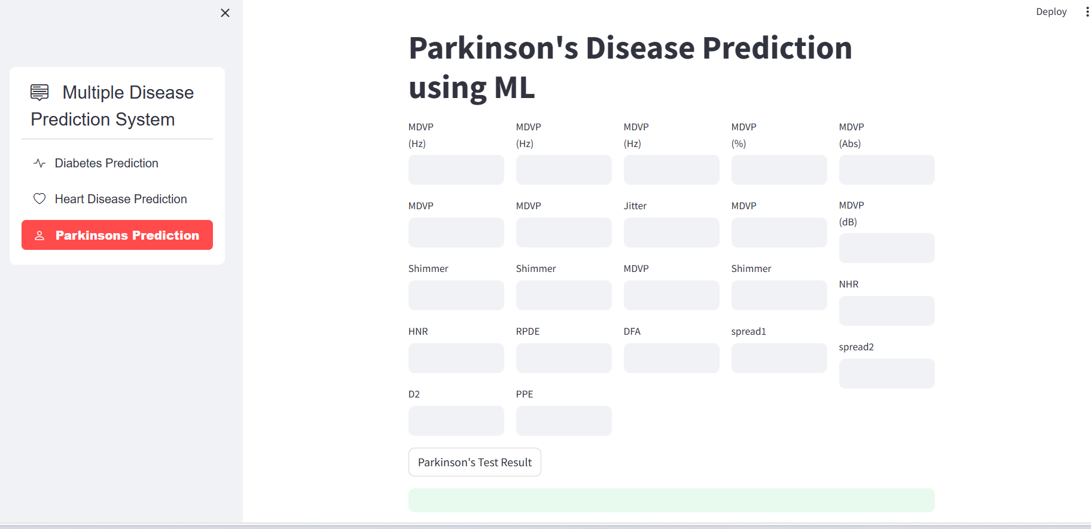

Slide 13
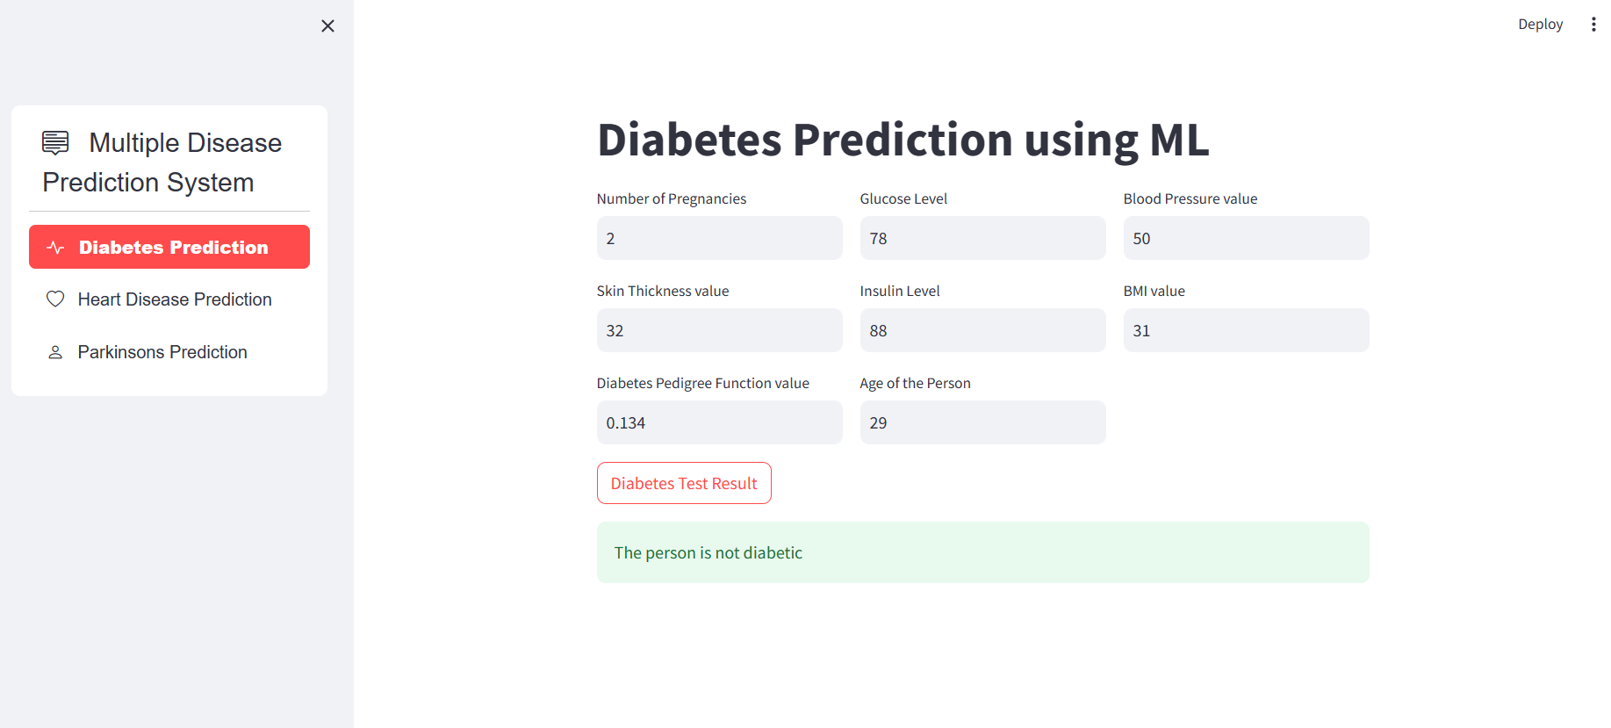
RESULTS

Slide 14

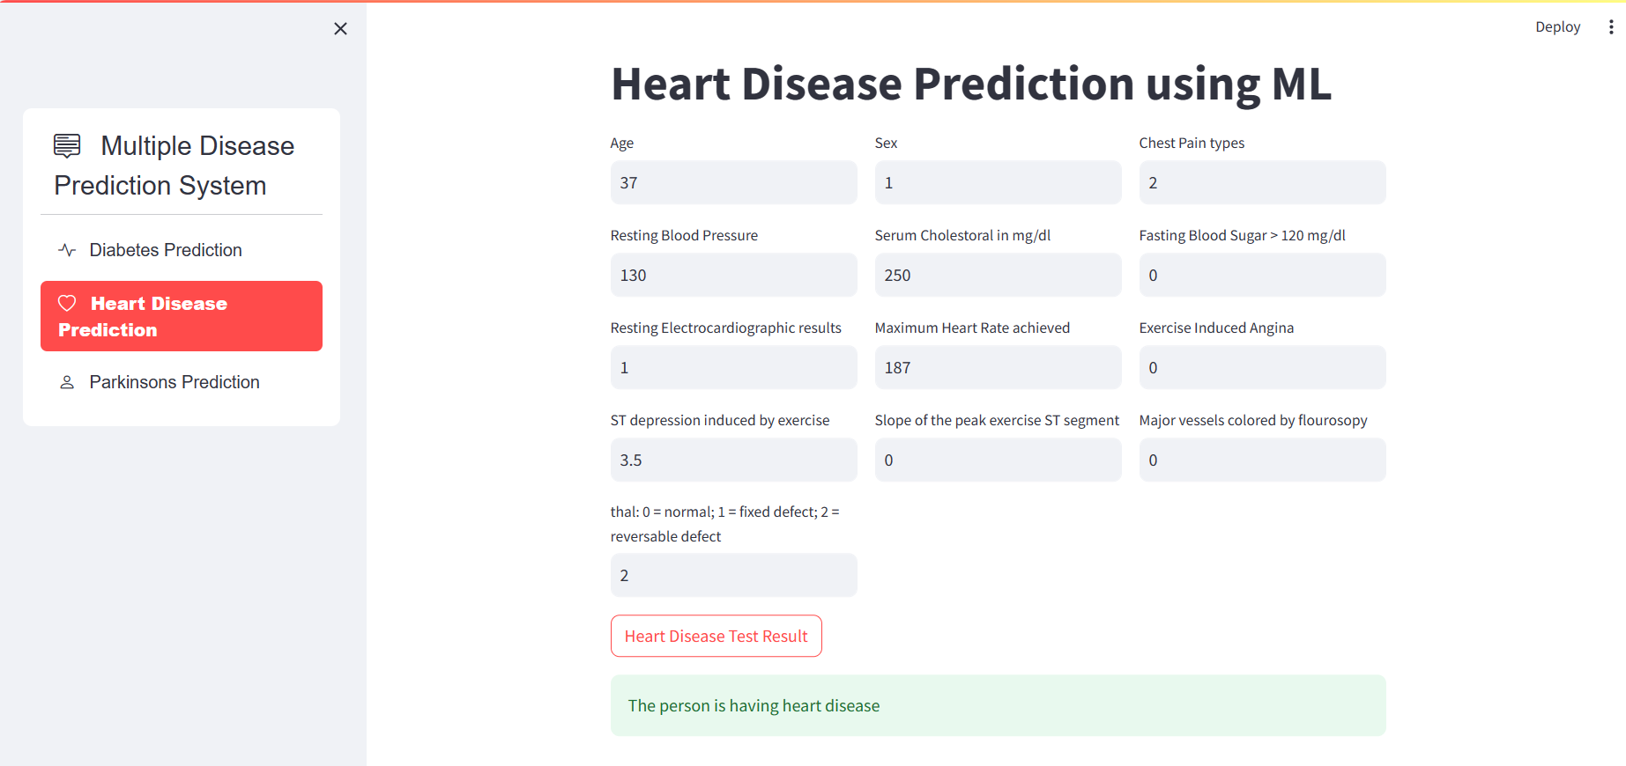

Slide 15
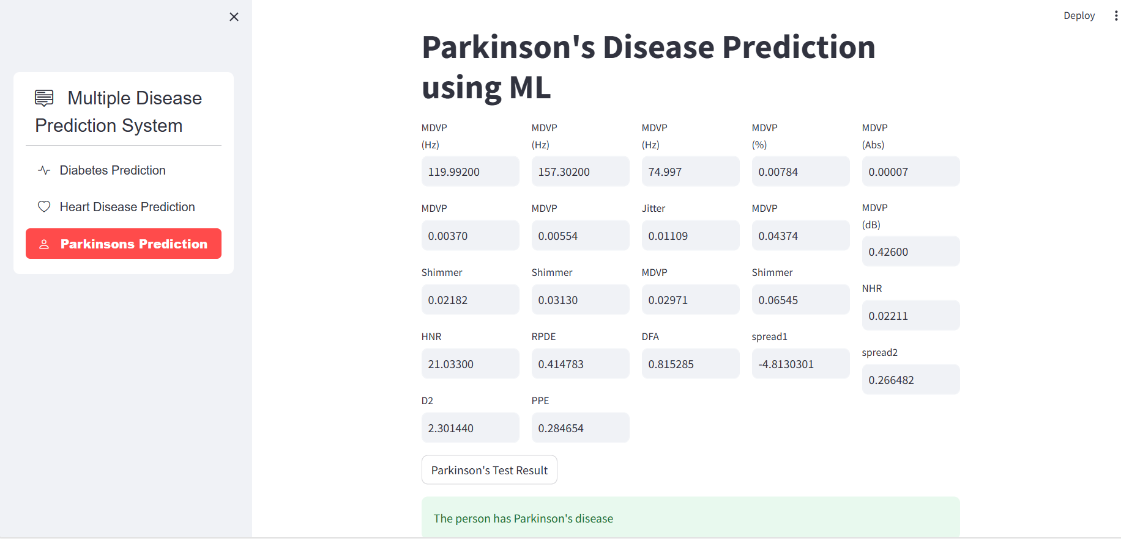

Slide 16
CONCLUSION
The Multiple Disease Prediction System employs Streamlit and machine learning models to offer a user-friendly interface for predicting diabetes, heart disease, and Parkinson's disease. With efficient deployment and adaptable design, it provides accurate health predictions, making it a valuable tool for quick and accessible disease diagnosis.

Slide 17
PROJECT GITHUB LINK
https://github.com/19PA1A0465/Disease-predictive-system

Slide 18
Thank You

